Slide 1
Corona virus Analysis using sql
By Wajeeha nouman

Slide 2
INTRODUCTION
The coronavirus, also known as COVID-19, is a highly contagious respiratory illness caused by the novel coronavirus SARS-CoV-2. It was first identified in Wuhan, China in December 2019 and has since spread globally, leading to a pandemic. The virus primarily spreads through respiratory droplets when an infected person coughs, sneezes, or talks. Symptoms of COVID-19 can range from mild to severe and may include fever, cough, shortness of breath, fatigue, and loss of taste or smell. It is important to follow public health guidelines such as wearing masks, practicing social distancing, and washing hands frequently to prevent the spread of the virus.

Slide 3
DATA DETAILS
PROVINCE : Geographic subdivision within a country/region.
COUNTRY: Geographic record where data is stored..
LATITUDE: North-South position on earth surface.
LONGITUDE: East-West position on earth surface.
DATA: Recoded data of Corona Virus.
VERIFIED: Number of diagnosed corona cases.
FATALITIES: Number of deaths due to Corona-Virus.
RETRIVED: Number of recovered patients from Corona-Virus.

Slide 4
QUERIES
Check whether data have null values:
Select from corona.virus
Where NOT(Province IS NOT NULL AND
Country IS NOT NULL AND
Latitude IS NOT NULL AND
Longitude IS NOT NULL AND
Date IS NOT NULL AND
Confirmed IS NOT NULL AND
Deaths IS NOT NULL AND
Recovered IS NOT NULL AND);
Update null values with ‘0’:
Update corona.virus
Set
Province = COALESCE(Province,’0’),
Country = COALESCE(Country,’0’),
Latitude = COALESCE(Latitude, ‘0’),
Date = COALESCE(Date, ‘0’),
Confirmed=COALESCE(Confirmed,’0’),
Deaths=COALESCE(Deaths, ‘0’),
Reacovered=COLESCE(Recovered,’0’);

Slide 5
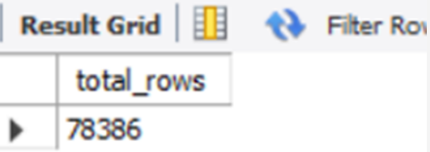
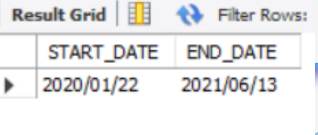
QUERIES
check total number of rows in dataset:
SELECT COUNT(*) AS total-rows
FROM corona.virus;
Check what is start_date and end_date:
SELECT min(DATE) AS START-DATE,
max(DATE) AS END-DATE
FROM corona.virus;

Slide 6
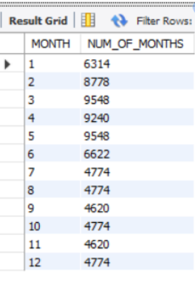
QUERIES
Number of months present in dataset :
SELECT
EXTRACT (Month From Date) AS Month,
Count(*) AS NUM-OF-MONTHS
FROM
Corona.virus
GROUP BY
extract(MONTH FROM Date);

Slide 7
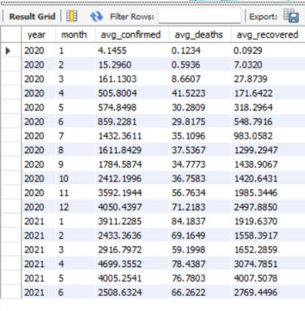
QUERIES
Find monthly average for confirmed, deaths , recovered:
SELECT
YEAR(Date) AS YEAR,
MONTH(Date) AS MONTH,
AVG(Confirmed) AS avg-confirmed,
AVG(Deaths) AS avg-deaths,
AVG(Recovered) AS avg-recovered
FROM
corona.virus
GROUP BY
YEAR(Date) , MONTH(Date);

Slide 8
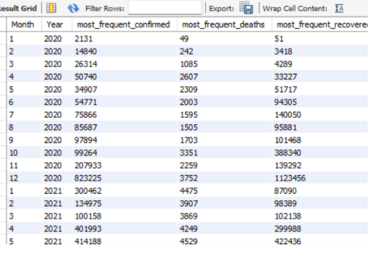
QUERIES
Find most frequent value for confirmed, deaths, recievered each month:
SELECT MONTH(date) AS MONTH, YEAR(date) AS YEAR,
MAX(confirmed) AS most-frequent-confirmed,
MAX(deaths) AS most-frequent-deaths,
MAX(recovered) AS most-frequent-recovered
FROM corona.virus
GROUP BY MONTH,YEAR
ORDER BY YEAR,MONTH;

Slide 9
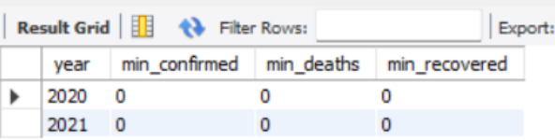
QUERIES
Find minimum values for confirmed, recovered, deaths per year:
SELECT
YEAR(date) AS Year,
MIN(confirmed) AS min-confirmed,
MIN(deaths) AS min-deaths,
MIN(recovered) AS min-recovered
FROM corona.virus
GROUP BY
YEAR(date);

Slide 10
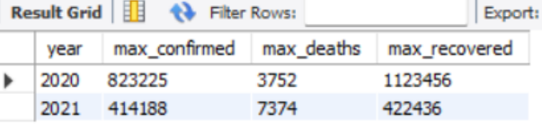
Queries
Find maximum values for confirmed, deaths, recovered per Year:
SELECT
YEAR(date) AS Year,
MAX(confirmed) AS min-confirmed,
MAX(deaths) AS min-deaths,
MAX(recovered) AS min-recovered
FROM corona.virus
GROUP BY
YEAR(date);

Slide 11
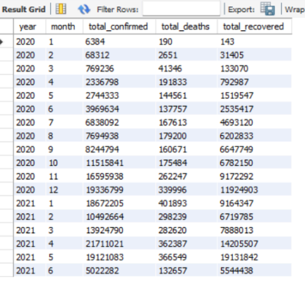
QUERIES
Total number of cases of confirmed, deaths and recovered patients:
SELECT
YEAR(date) AS Year,
MONTH(date) AS Month,
SUM(confirmed) AS total-confirmed,
SUM(deaths) AS total-deaths,
SUM(recovered) AS total-recovered
FROM corona.virus
GROUP BY
YEAR(date), MONTH(date);

Slide 12
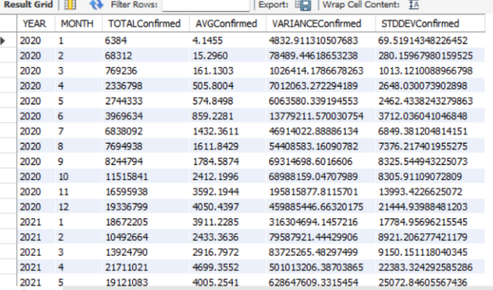
QUERIES
How corona virus spread out with respect to confirmed cases:
SELECT
YEAR(date) AS Year,
MONTH(date) AS Month,
SUM(confirmed) AS Totalconfirmed,
AVG(confirmed) AS AVGConfirmed,
Variance(confirmed) AS VarianConfirmed,
STDDEV(confirmed) AS STDDEVConfirmed
FROM corona.virus
GROUP BY
YEAR(date), MONTH(date)
ORDER BY
YEAR(date), MONTH(date);

Slide 13
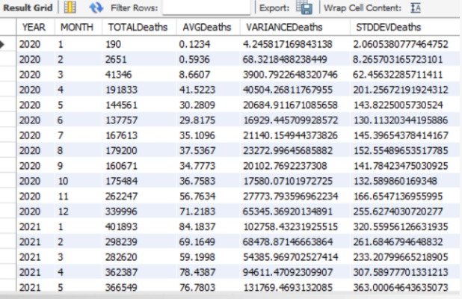
QUERIES
How corona virus spread out with respect to death cases:
SELECT
YEAR(date) AS Year,
MONTH(date) AS Month,
SUM(Deaths) AS TotalDeaths,
AVG(Deaths) AS AVGDeaths,
Variance(Deaths) AS VarianDeaths,
STDDEV(Deaths) AS STDDEVDeaths
FROM corona.virus
GROUP BY
YEAR(date), MONTH(date)
ORDER BY
YEAR(date), MONTH(date);

Slide 14
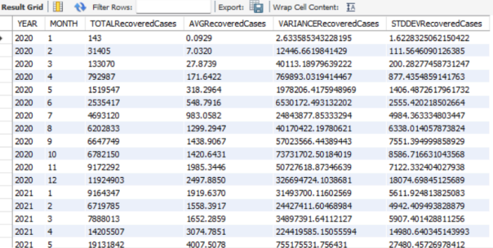
Queries
How corona virus spread out with respect to recovered cases:
SELECT
YEAR(date) AS Year,
MONTH(date) AS Month,
SUM(Recovered) AS TotalRecoveredcases,
AVG(Recovered) AS AVGRecoveredcases,
Variance(Recovred) AS VarianRecoveredcases,
STDDEV(Recovered) AS STDDEVRecoveredcases
FROM corona.virus
GROUP BY
YEAR(date), MONTH(date)
ORDER BY
YEAR(date), MONTH(date);

Slide 15
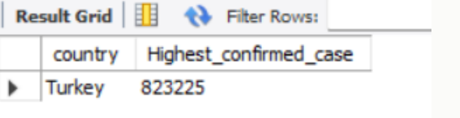
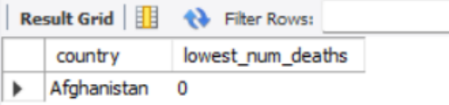
Queries
Countries having highest number of confirmed cases:
SELECT Country, max(confirmed) as Highest- confirmed-case
FROM corona.virus
Group by Country
Order by Highest-confirmed-case desc limit 1;
Countries having lowest number of death cases:
SELECT Country, min(deaths) as lowest- num-deaths
FROM corona.virus
Group by Country
Order by lowest-num-deaths desc limit 1;

Slide 16
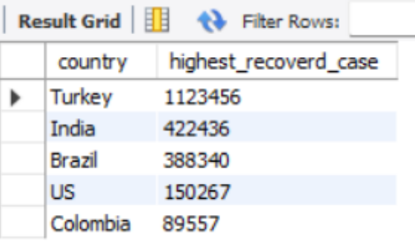
Queries
Find top five countries having recovered cases:
SELECT Country, max(recovered) as Highest- recovered-case
FROM corona.virus
Group by Country
Order by Highest-recovered-case
desc limit 1;

Slide 17


